Slide 1

ICT — WEEK 4
APPLICATIONS OF
INFORMATION &
COMMUNICATION
TECHNOLOGIES
Lectures 7 & 8: The Systems Life Cycle & Communication
Course Materials — Academic Year 2025/2026

Slide 2
AGENDA
Today's Sessions
01
02
The Systems Life Cycle
Communication
Understanding the structured approach to developing ICT systems — from initial analysis through to final evaluation
Exploring communication media and technologies for information exchange in the digital age
▶ Analysis & Design
▶ Development & Testing
▶ Implementation & Documentation
▶ Evaluation
▶ Newsletters, Posters & Websites
▶ Multimedia, Audio & Video
▶ Media Streaming & ePublications
▶ Mobile Communication
ICT Week 4
2 / 26

Slide 3

01
LECTURE 7
The Systems Life Cycle
Understanding the structured approach to developing ICT systems — from initial analysis through to final evaluation

Slide 4
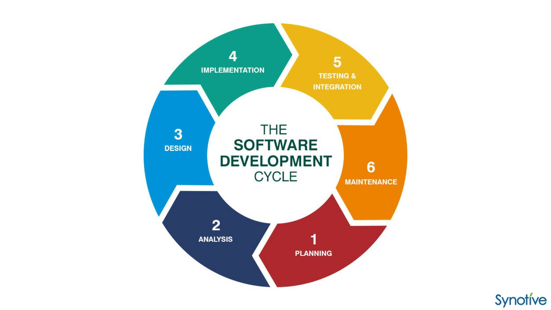
What is the Systems Life Cycle?
The Systems Life Cycle (SLC) is a structured methodology for developing, implementing, and maintaining information systems.
It provides a phased approach ensuring all aspects of system development are addressed systematically. Each phase has defined inputs, processes, and outputs.
Also known as the Systems Development Life Cycle (SDLC), it ensures quality, reduces risk, and improves project management.
The 7 Key Phases:
Analysis → Design → Development → Testing → Implementation → Documentation → Evaluation
Key Insight: The SLC is not strictly linear — after Evaluation, the cycle may restart for system maintenance, upgrades, or when new requirements emerge. This creates a continuous improvement loop.
ICT Week 4
4 / 26

Slide 5
Analysis — Understanding the Problem
The Analysis phase is the foundation of the entire systems life cycle. It focuses on understanding what the system needs to achieve.
Critical Question: "What does the system need to do?"
Techniques Used
▶ Interviews with stakeholders
▶ Questionnaires and surveys
▶ Direct observation of workflows
▶ Analysis of existing documents
▶ Prototyping and workshops
Key Activities
■ Gathering and documenting requirements
■ Studying existing systems and workflows
■ Identifying problems and bottlenecks
■ Defining clear project objectives
■ Conducting feasibility studies
Key Deliverables
● Requirements Specification
● Feasibility Study Report
● Problem Definition Document
Involves: End users, management, IT staff, clients, and domain experts — all contributing perspectives to build a complete picture of system requirements.
ICT Week 4
5 / 26

Slide 6
Design — Planning the Solution
The Design phase transforms requirements into a detailed blueprint. It answers: "How will the system achieve its objectives?"
System Design
Detailed Design
■ Overall system architecture
■ Module and component structure
■ Data flow diagrams
■ Integration points
▶ Database schemas and structures
▶ User interface mockups and wireframes
▶ Algorithms and pseudocode
▶ API specifications
Key Design Considerations
Scalability | Security | Usability | Performance | Maintainability
Can the system grow with demand? | Is data and access protected? | Is it intuitive for users? | Does it respond quickly? | Can it be easily updated?
ICT Week 4
6 / 26

Slide 7

Development — Building the System
The Development phase involves actual coding and construction based on design specifications. Programmers write code, create databases, and integrate components.
Key activities include coding, unit testing, database creation, and component integration. Version control tracks changes and manages collaboration.
Development Approaches
Waterfall Model
Agile Model
Sequential approach where each phase must be completed before the next begins. Best for projects with well-defined, stable requirements.
Iterative approach with frequent feedback and adaptive planning. Best for projects with evolving requirements and need for flexibility.
Quality Assurance: Code reviews, peer programming, and continuous integration ensure the system meets standards before moving to comprehensive testing.
ICT Week 4
7 / 26

Slide 8
Testing — Ensuring Quality
The Testing phase verifies the system works correctly and meets all requirements. It involves multiple levels of testing to catch defects before deployment.
Test Type | What It Tests | Goal
Unit Testing | Individual components or modules in isolation | Verify each part works correctly on its own
Integration Testing | How components work together | Ensure modules interact properly
System Testing | The complete system as a whole | Validate end-to-end functionality
UAT | System against user requirements | Confirm it meets business needs
Additional Testing Types
Performance Testing — Ensures the system handles expected load and stress. Security Testing — Identifies vulnerabilities. Usability Testing — Validates user-friendliness.
Goal: Deliver a reliable, error-free system ready for real-world use.
ICT Week 4
8 / 26

Slide 9
Implementation — Going Live
The Implementation phase deploys the system into the live environment. Choosing the right strategy balances risk, cost, and business continuity.
Four Implementation Strategies
Direct Changeover
Parallel Running
Phased
Pilot Running
Immediate switch from old to new system
High risk | Low cost
Old and new systems run simultaneously
Low risk | High cost
Gradual rollout by module or department
Balanced
Trial in one location before full rollout
Low risk
Data Migration: Transferring data from old systems requires careful planning, validation, and backup procedures to prevent data loss.
User Training: Essential for successful adoption — includes hands-on sessions, documentation, and ongoing support during the transition period.
Rollback Plan: Always have a contingency plan to revert to the old system if critical issues arise during implementation.
ICT Week 4
9 / 26

Slide 10
Documentation — Recording Everything
Documentation provides a comprehensive record of the system for current and future use. Good documentation reduces support costs and improves maintainability.
Technical Documentation
User Documentation
■ System architecture diagrams
■ Code comments and inline documentation
■ Database schemas and ER diagrams
■ API references and endpoints
■ Configuration and deployment guides
■ Version control history
▶ User manuals and guides
▶ Quick start tutorials
▶ Frequently Asked Questions (FAQs)
▶ Training materials and videos
▶ Troubleshooting guides
▶ Release notes and changelogs
Best Practices: Documentation should be clear, accurate, up-to-date, and accessible. Use standards and templates to ensure consistency across all projects.
ICT Week 4
10 / 26

Slide 11
Evaluation — Measuring Success
The Evaluation phase assesses whether the system meets its original objectives. It feeds back into the cycle for continuous improvement.
Evaluation Criteria
Evaluation Methods
■ Performance — Does it meet requirements?
■ Cost-Benefit — Was it worth the investment?
■ User Satisfaction — Are users happy?
■ Reliability — Does it run consistently?
■ Efficiency — Are processes improved?
▶ User feedback surveys and interviews
▶ Performance metrics and benchmarks
▶ Comparison with baseline measurements
▶ Post-implementation review meetings
▶ Identifying lessons learned
Key Questions to Ask
Does it work? Is it efficient? Are users satisfied? Was it worth the investment? What can be improved? The cycle may restart for maintenance, upgrades, or new requirements.
ICT Week 4
11 / 26

Slide 12
The Systems Life Cycle — Complete Overview
ANALYSIS
DESIGN
DEVELOP
TESTING
IMPLEMENT
DOCUMENT
EVALUATE
Feedback loop — cycle restarts for maintenance & upgrades
Phase Summary
Phase | Focus | Key Output
Analysis | Understanding requirements | Requirements Specification
Design | Planning the solution | System Architecture & Mockups
Development | Building the system | Working Code & Database
Testing | Ensuring quality | Test Reports & Bug Fixes
Implementation | Deploying the system | Live System & Training
Documentation | Recording everything | User & Technical Manuals
Evaluation | Measuring success | Review Report & Improvements
ICT Week 4
12 / 26

Slide 13

02
LECTURE 8
Communication
Exploring communication media and technologies for information exchange in the digital age

Slide 14
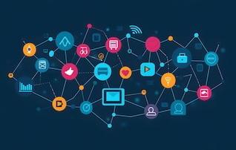
Introduction to Communication Media
Communication media are channels and tools used to convey information to audiences. In ICT, they span from traditional print to digital multimedia.
Digital media have transformed how organizations communicate with stakeholders. Effective communication often uses multiple media in an integrated approach.
Key Characteristics to Evaluate
Reach
Cost
Interactivity
Choosing the right medium depends on:
▶ Target audience
▶ Message type
▶ Budget constraints
▶ Urgency of delivery
▶ Desired response
Accessibility
Speed
Permanence
ICT Week 4
14 / 26

Slide 15
Newsletters — Regular Information Updates
Newsletters are periodic publications distributed to a subscribed audience. They provide regular updates and build ongoing relationships with readers.
Types include email newsletters, printed newsletters, and web-based newsletters.
Common Uses
Advantages
■ Internal company updates and announcements
■ Marketing campaigns and product launches
■ Community and educational content
▶ Builds ongoing audience relationships
▶ Cost-effective distribution
▶ Measurable engagement (digital)
Best Practices
Use clear subject lines | Design mobile-friendly layouts | Provide valuable, relevant content | Include a clear call-to-action | Maintain consistent scheduling | Track open and click rates
ICT Week 4
15 / 26

Slide 16
Posters — Visual Impact Communication
Posters are visual displays designed to attract attention and convey a message quickly. The message must be understood within 3-5 seconds of viewing.
C.A.R. Design Principles
C
Contrast
A
Alignment
R
Repetition
P
Proximity
Create visual hierarchy through differences in size, color, and weight
Organize elements along clean lines for a professional, polished look
Repeat visual elements to create consistency and strengthen identity
Group related elements together to create clear visual relationships
Uses & Formats
Digital posters can be displayed on screens, shared on social media, or printed. They combine compelling visuals, concise text, and clear hierarchy to communicate effectively at a glance.
■ Event promotion and advertising
■ Public awareness campaigns
■ Educational displays
■ Digital posters for social media
ICT Week 4
16 / 26

Slide 17

Websites — Digital Presence & Information Hubs
Websites are comprehensive digital platforms for information, interaction, and transactions. They serve as the central hub connecting all other digital communication channels.
Over 60% of web traffic comes from mobile devices — mobile responsiveness is essential.
Types of Websites
■ Informational — Company profiles, portfolios
■ E-commerce — Online stores and marketplaces
■ Blogs — Content publishing platforms
■ Portals — Aggregated services and links
■ Educational — Learning management systems
Key Components
Domain Name — Unique web address | Hosting — Server space for files | CMS — Content management (WordPress, Drupal)
Design — Visual layout and UX | SEO — Search engine optimization | Analytics — Traffic and behavior tracking
ICT Week 4
17 / 26

Slide 18
Multimedia Presentations
Multimedia presentations combine text, images, audio, video, and animation to deliver messages. They enhance retention — people remember 65% of visual content vs. 10% of text alone.
Common Presentation Tools
Best Practices:
▶ Limit text per slide
▶ Use high-quality visuals
▶ Maintain consistent design
▶ Practice your delivery
▶ Engage your audience
Microsoft
PowerPoint
Google
Slides
Prezi
Apple
Keynote
Canva
Effective For
Lectures and classroom teaching | Business pitches and proposals | Training sessions and workshops | Conference talks and keynotes | Product demonstrations
ICT Week 4
18 / 26

Slide 19
Audio Communication
Audio communication uses sound as the primary medium. It is portable, cost-effective, and creates a personal connection with the audience.
500M+
podcast listeners worldwide
Audio Formats
Podcasts
On-demand audio series
Radio Broadcasts
Live audio programming
Audiobooks
Narrated publications
Voice Messages
Personal audio communication
Announcements
Public audio notices
Key Advantages
■ Can be consumed while multitasking (driving, exercising, commuting)
■ Creates an intimate, personal connection with the audience
■ Cost-effective production compared to video content
■ Wide range of applications: education, entertainment, news, marketing
ICT Week 4
19 / 26

Slide 20
Video Communication
Video combines moving images with audio for powerful, engaging communication. It accounts for over 82% of all internet traffic globally.
82%
of all internet traffic is video
Types of Video Content
Promotional
Tutorials
Webinars
Major Platforms
Production Considerations
▶ YouTube — Largest video sharing platform
▶ TikTok — Short-form viral content
▶ Vimeo — Professional hosting
▶ Instagram Reels — Social video
■ Scripting and storyboarding
■ Filming equipment and setup
■ Editing and post-production
■ Accessibility (captions/subtitles)
ICT Week 4
20 / 26

Slide 21

Media Streaming
Media streaming delivers audio and video content continuously over the internet without downloading files to the device.
Two Types of Streaming
Live Streaming
On-Demand Streaming
Real-time broadcast of events as they happen. Used for sports, concerts, gaming, news, and live events.
Pre-recorded content available anytime. Users choose what to watch and when — full control.
Major Streaming Platforms
Netflix
Spotify
YouTube
Twitch
Disney+
Prime
Underlying Technology
CDNs (Content Delivery Networks) | Compression Codecs (H.264, HEVC, AV1) | Adaptive Bitrate streaming | Cloud Storage infrastructure
ICT Week 4
21 / 26

Slide 22
ePublications — Digital Publishing
ePublications are digital versions of printed materials distributed electronically. They offer searchable text, hyperlinks, and multimedia embedding.
Types of ePublications
Common Formats
▶ PDF — Universal, fixed layout
▶ EPUB — Reflowable, e-reader friendly
▶ MOBI — Kindle format
▶ HTML5 — Interactive web publications
E-Books
E-Magazines
Advantages
Digital Reports
Online Journals
■ Lower distribution costs
■ Instant global delivery
■ Environmental benefits
■ Analytics and reader tracking
Self-Publishing Platforms: Amazon Kindle Direct Publishing | Apple Books | Issuu | Medium | Google Play Books
These platforms have democratized publishing, allowing anyone to create and distribute digital content globally.
ICT Week 4
22 / 26

Slide 23
Mobile Communication — Overview
Mobile communication refers to information exchange using portable wireless devices. The mobile revolution has fundamentally changed how people communicate and access information.
8.9 Billion
mobile connections worldwide
Key Characteristics
Portability
Always Connected
Location-Aware
App Ecosystem
Communicate anywhere
24/7 internet access
GPS and local services
Millions of applications
Scope of Mobile Communication
■ Voice Calls — Traditional and VoIP calling
■ SMS/MMS — Text and multimedia messaging
■ Mobile Internet — Web browsing and cloud access
■ Mobile Apps — Dedicated application experiences
■ Mobile Payments — Digital wallets and transactions
ICT Week 4
23 / 26

Slide 24
Mobile Communication Technologies
Evolution of Mobile Networks
1G
Analog voice
2G
Digital + SMS
3G
Mobile internet
4G/LTE
High-speed data
5G
Ultra-fast + IoT
5G Key Capabilities
Speed: Up to 10 Gbps | Latency: Ultra-low (1ms) | Density: 1M devices/km² | Use Cases: Autonomous vehicles, smart cities, remote surgery, AR/VR
Key Mobile Technologies
Technology | Purpose | Applications
Cellular Networks | Wide-area wireless communication | Voice, data, messaging
Wi-Fi / Bluetooth | Local wireless connectivity | Internet, file sharing, peripherals
NFC / GPS | Near-field + location services | Payments, navigation, tracking
ICT Week 4
24 / 26

Slide 25
Mobile Communication Applications
Mobile communication has transformed industries through a vast ecosystem of applications serving billions of users worldwide.
Messaging Apps
Social Media
Mobile Commerce
WhatsApp, Messenger, WeChat, Telegram — billions of users
Instagram, TikTok, Twitter/X, LinkedIn — real-time content sharing and community building
Shopping, banking, payments via Apple Pay, Google Pay, and mobile wallets
Mobile Work
Location Services
Global Impact
Email, video conferencing (Zoom, Teams), cloud collaboration, project management tools
Navigation, ride-sharing, food delivery, local search, and geofencing
Democratized information access and transformed every industry worldwide
Mobile Operating Systems
Android (Google)
iOS (Apple)
HarmonyOS (Huawei)
ICT Week 4
25 / 26

Slide 26

Key Takeaways
The Systems Life Cycle provides a structured, 7-phase approach to developing quality ICT systems — from Analysis through Evaluation.
Communication media range from traditional newsletters and posters to modern streaming and mobile platforms.
Choosing the right communication medium depends on audience, message, budget, and desired response.
Mobile communication continues to reshape how we interact with information and each other — with 8.9B+ connections.
THANK YOU
Applications of Information and Communication Technologies — Week 4

